Slide 1

Systolic array

Slide 2

intro

Slide 3
definition
Systolic array is a method used to apply matrix multiplication in a new approach to make it easy for hardware implementation.

Slide 4
implementation
Hdl code

Slide 5
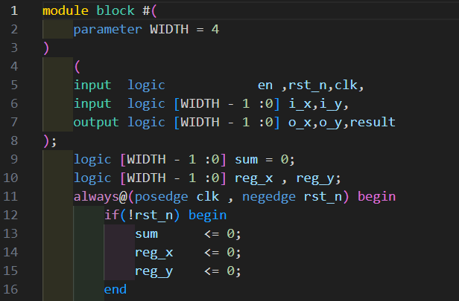
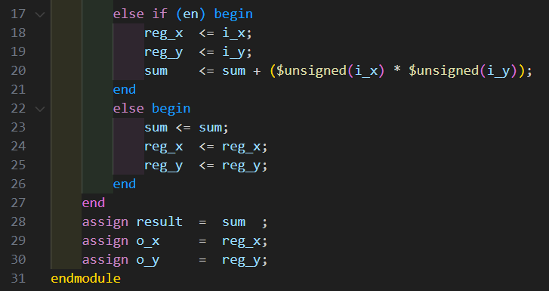
Basic block module

Slide 6
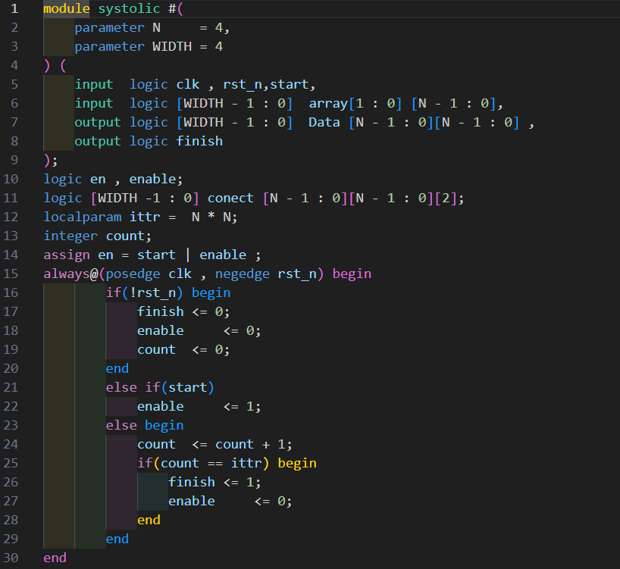
Connections in top module

Slide 7
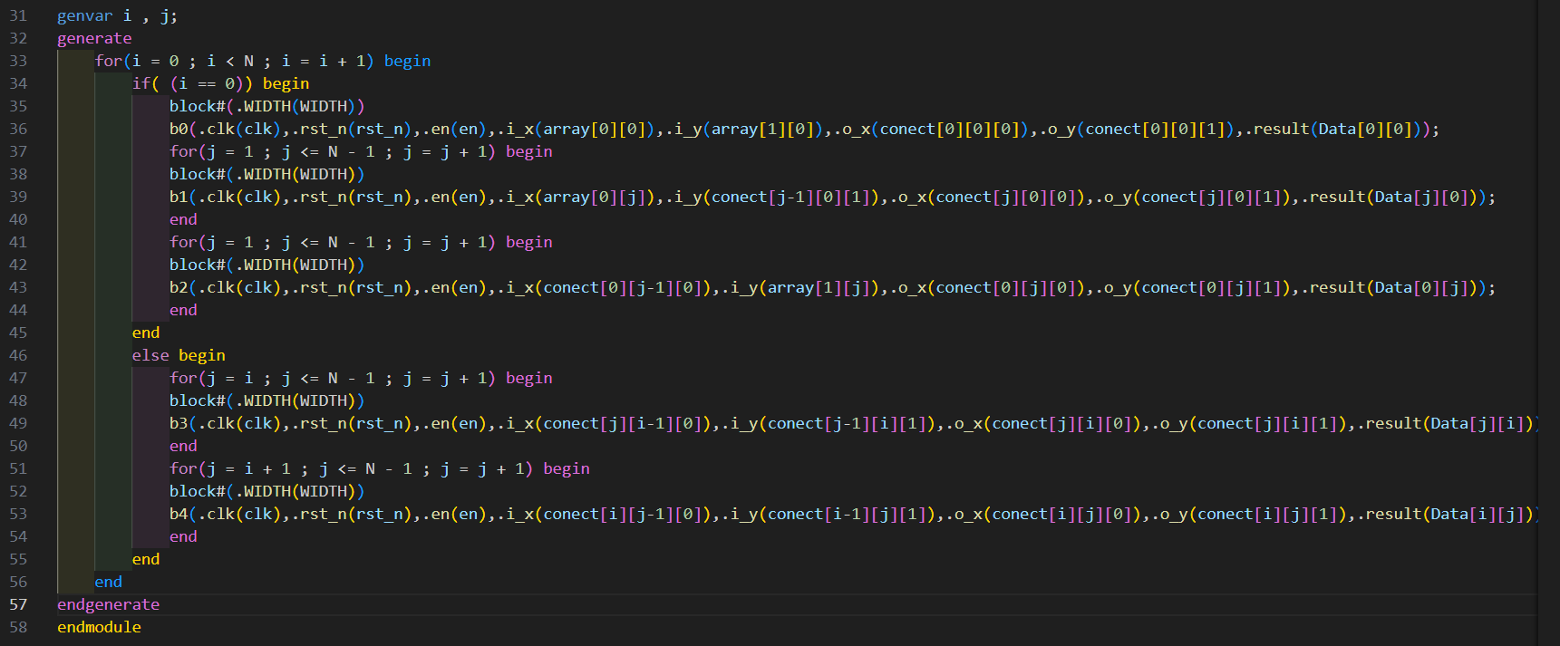
Connections in top module

Slide 8
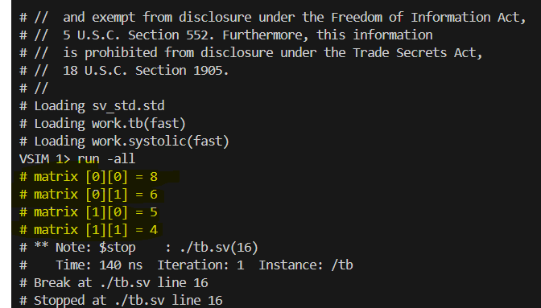
testing
2x2 matrix multiplication

Slide 9
testing
The code is parameterized so it can work with NxN matrix size multiplication.
More exhaustive tests will be done soon.

Slide 10

THANK YOU
Aly Elruby
+0201127039571
alyelroby567@gmail.com

